Slide 1
Basics of
Problems Solving
Session 1

Slide 2
Objectives
Introduction to Problems Solving
Discuss algorithms
Draw flowcharts
List the symbols used in flowcharts

Slide 3
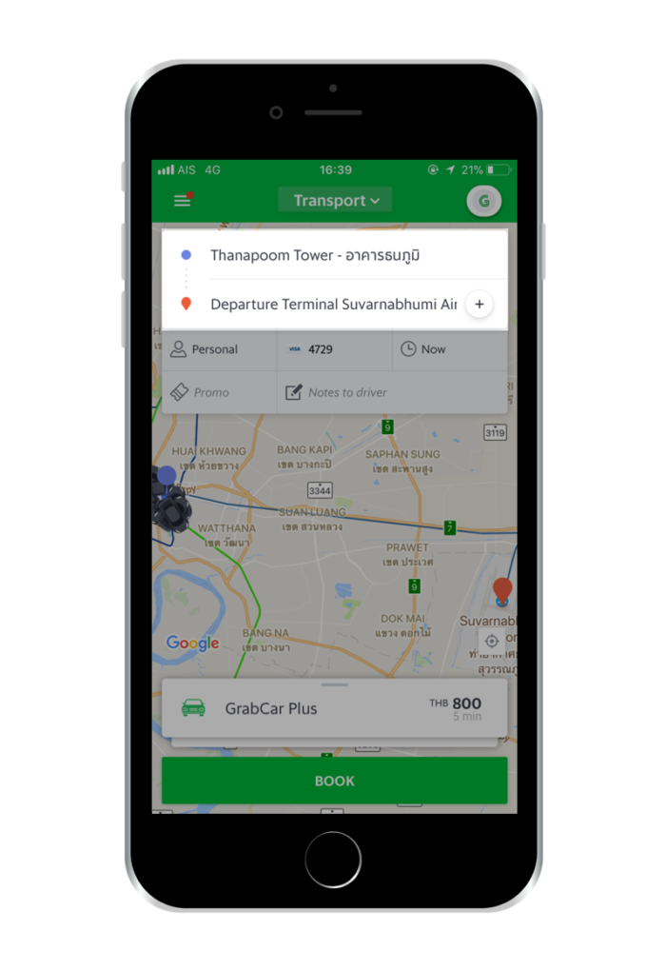

Slide 4




The Programming Approach to Solving Problems
Classroom
Algorithm is a set of steps that are performed to solve a problem. The example below describes an algorithm
Leaving the
classroom
Head towards
the staircase
Go to the
basement
Head for the
cafeteria
These are the steps followed when a student wants to go to the cafeteria from the classroom
Cafeteria

Slide 5
Solving a Problem
In order to solve a problem
Understand the problem clearly
Gather the relevant information
Process the information
Arrive at the solution

Slide 6
Pseudocode
It is not actual code. A method of algorithm - writing which uses a standard set of words which makes it resemble code
BEGIN
DISPLAY ‘Hello World !’
END
Each pseudocode starts with a BEGIN
To show some value , the word DISPLAY is used
The pseudocode finishes with an END

Slide 7
Flowcharts
It is a graphical representation of an algorithm
START
DISPLAY ‘Hello World !’
STOP

Slide 8
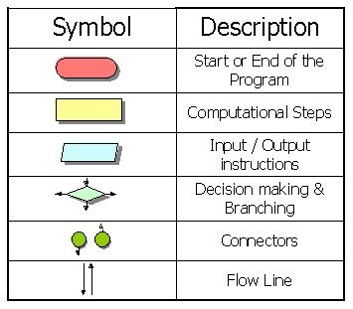
The Flowchart Symbol

Slide 9
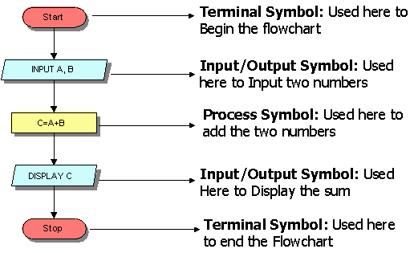
Flowchart to add two numbers

Slide 10
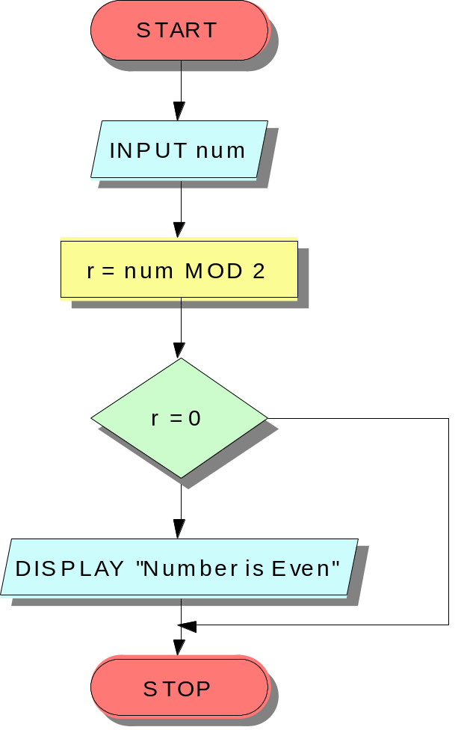
The IF Construct
BEGIN
INPUT num
r = num MOD 2
IF r=0
Display “Number is even”
END IF
END
No
Yes

Slide 11
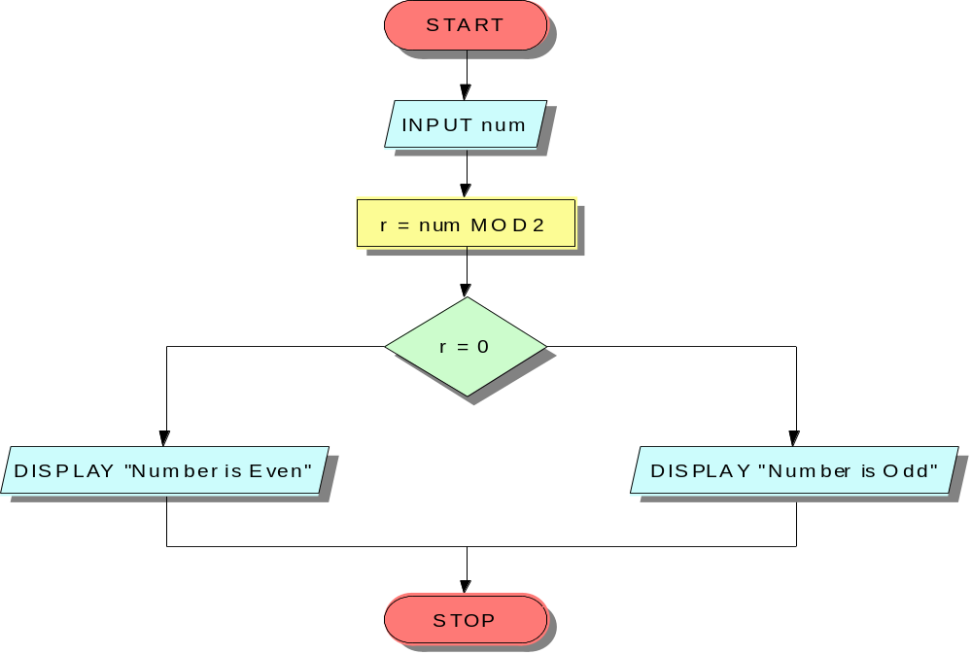
The IF-ELSE Construct
BEGIN
INPUT num
r=num MOD 2
IF r=0
DISPLAY “Even Number”
ELSE
DISPLAY “Odd Number”
END IF
END
Yes
No

Slide 12
Multiple criteria using AND/OR
BEGIN
INPUT yearsWithUs
INPUT bizDone
IF yearsWithUs >= 10 AND bizDone >=5000000
DISPLAY “Classified as an MVS”
ELSE
DISPLAY “A little more effort required!”
END IF
END

Slide 13
Nested IFs-1
BEGIN
INPUT yearsWithUs
INPUT bizDone
IF yearsWithUs >= 10
IF bizDone >=5000000
DISPLAY “Classified as an MVS”
ELSE
DISPLAY “A little more effort required!”
END IF
ELSE
DISPLAY “A little more effort required!”
END IF
END

Slide 14
Nested IFs-2
START
INPUT YearsWithUs
INPUT bizDone
YES
YearsWithUs >= 10
NO
DISPLAY “A Little more effort required”
NO
bizDone > 5000000
YES
DISPLAY “A Little more effort required”
DISPLAY “Classified as an MVS”
STOP

Slide 15
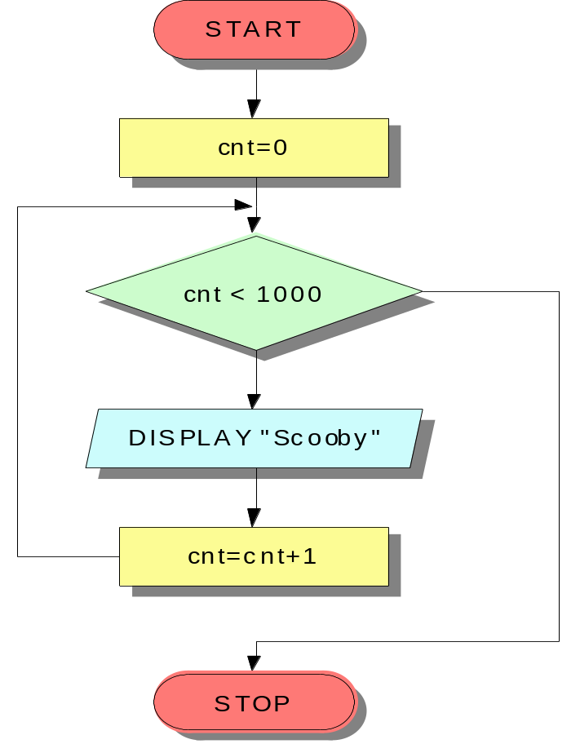
Loops
BEGIN
cnt=0
WHILE (cnt < 1000)
DO
DISPLAY “Scooby”
cnt=cnt+1
END DO
END
No
Yes

Slide 16
Exercises
Pseudocode & Flowchart

Slide 17
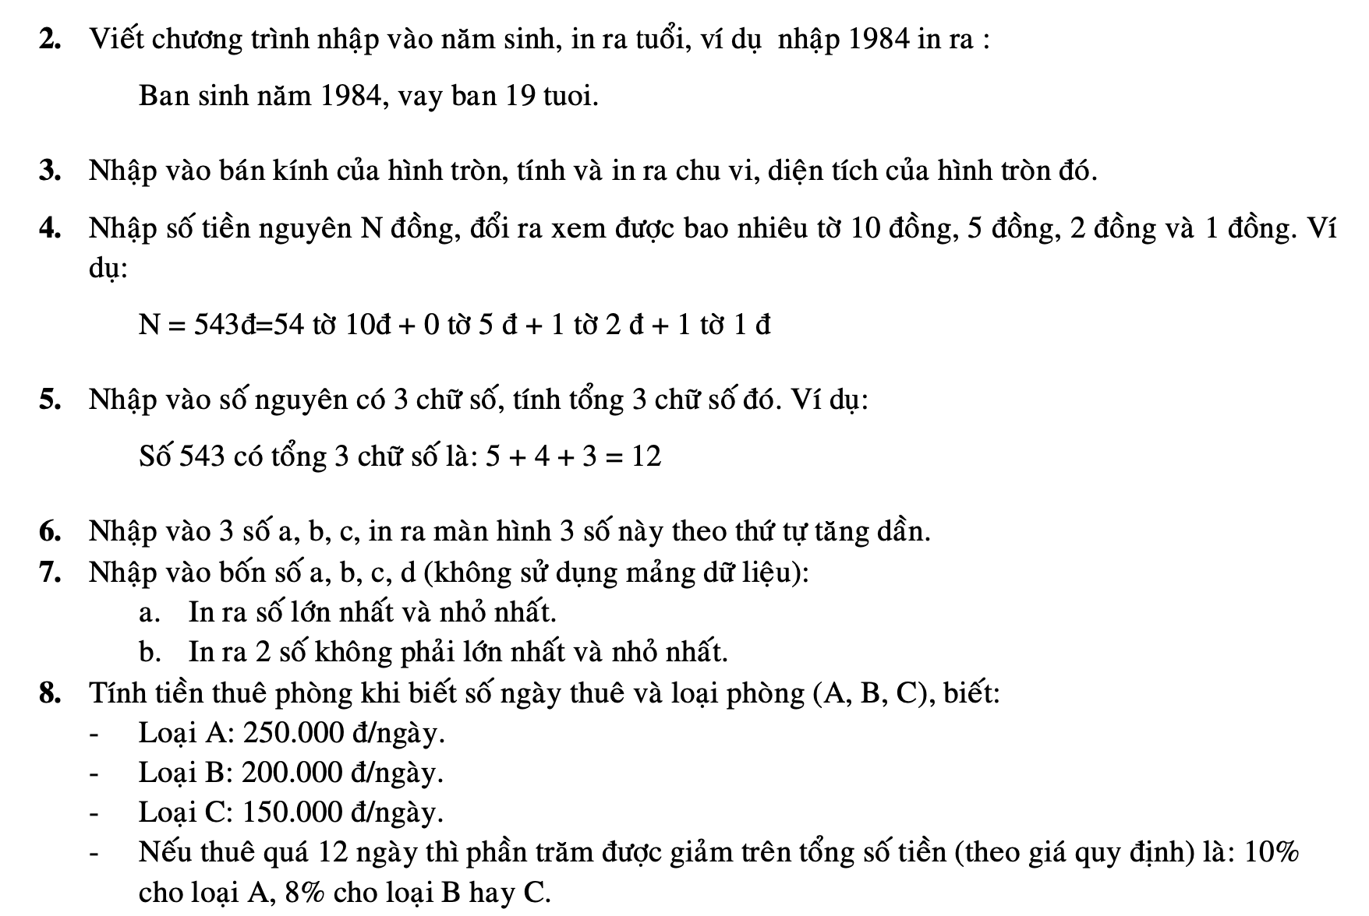
Exercises

Slide 18
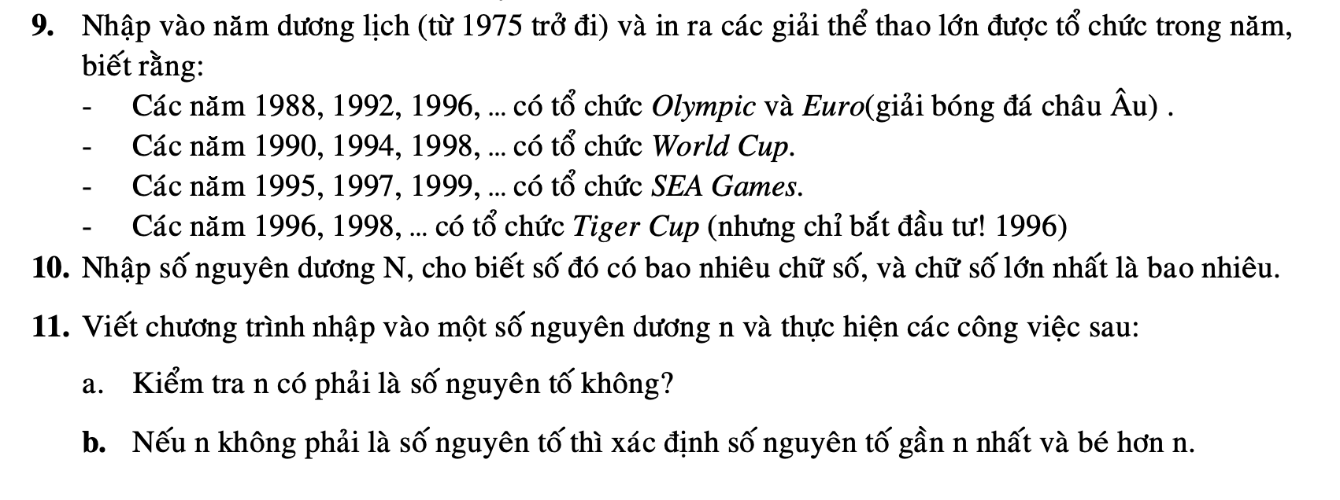
Exercises
Pseudocode & Flowchart

